Slide 2

Java Spring Boot Development in 2025:
Unlocking Career Opportunities

Slide 3
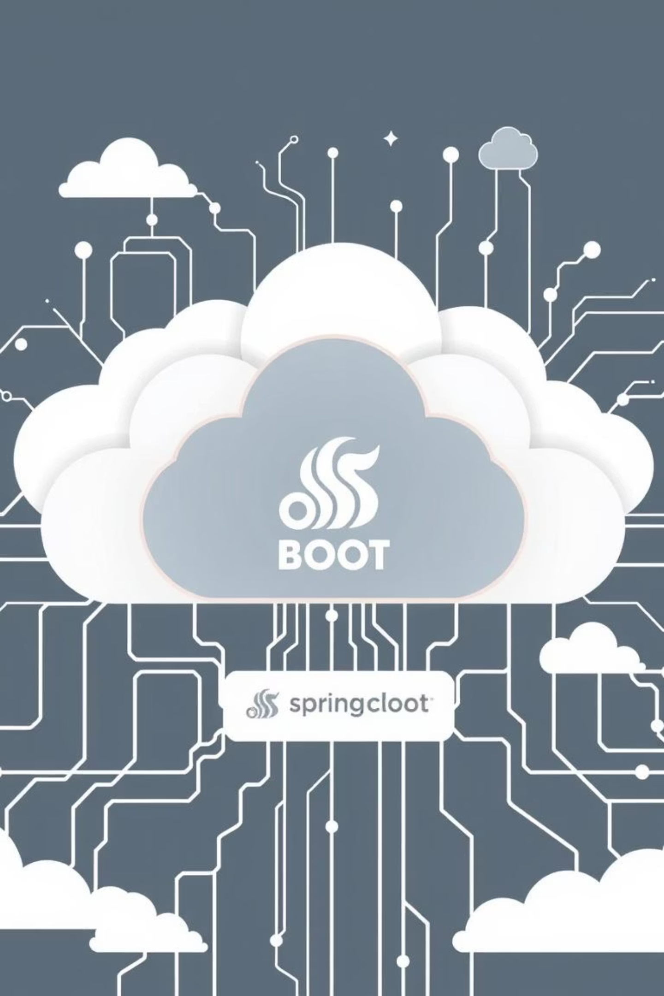



Why Spring Boot Remains a Top Choice in 2025
Enterprise Standard
Cloud-Native Powerhouse
De facto for backend systems
Scalable microservices for Fortune 500
Simplified Development
Convention-over-configuration, rich ecosystem

Slide 4
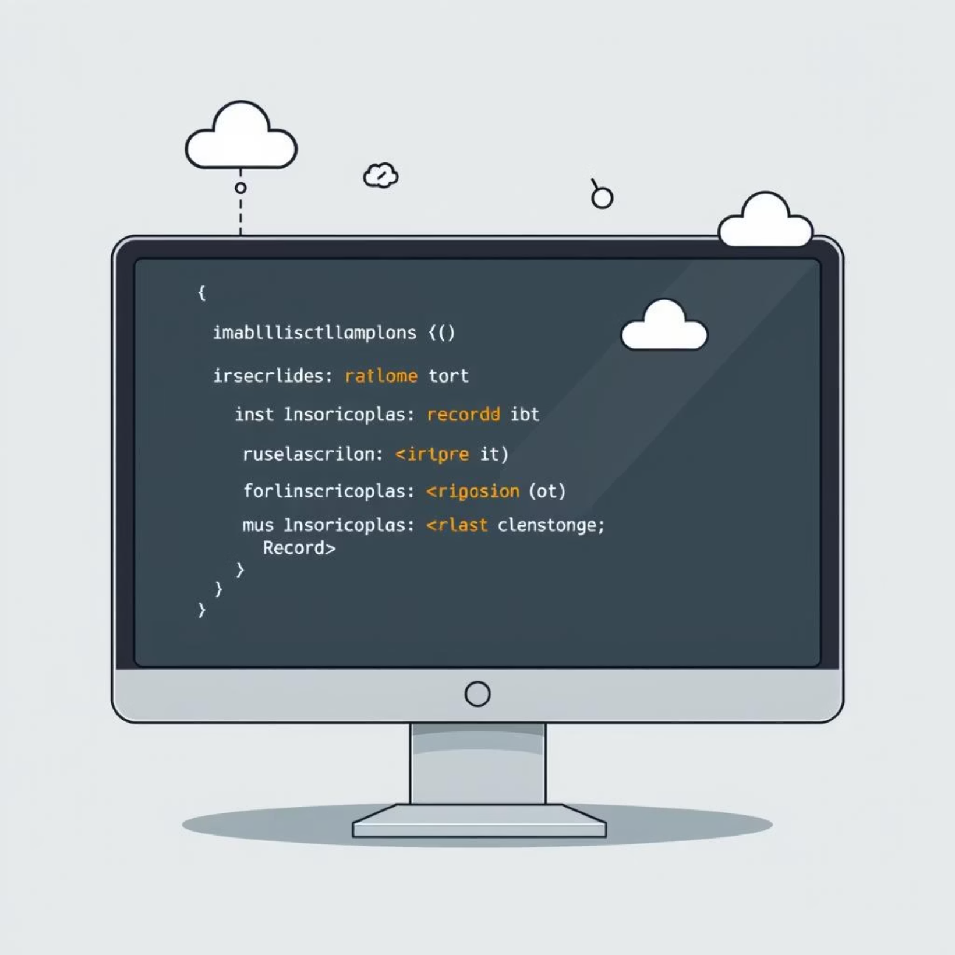
Java’s Enduring Dominance in 2025
90%+ Fortune 500 reliance
Modern features: lambda, modules, records
Strong ecosystem & community support

Slide 5




Essential Skills for Spring Boot Developers Today
Core Java Mastery
Spring Core Deep Dive
Fundamentals & modern language features
DI, Bean lifecycle, configuration
Secure REST APIs
Database Integration
Spring Security, JWT, OAuth2
Spring Data JPA, transactions

Slide 6



Advanced Spring Boot Topics Driving Innovation
Microservices & Reactive
Cloud & Containerization
API & Testing
WebFlux, event-driven design
Docker, Kubernetes, CI/CD
Documentation, best practices

Slide 7

Real-World Job Market Snapshot: Demand & Salary Insights
2K+
$133K
Open jobs in US alone
Average remote salary
$251K
Lead developer potential

Slide 8
Career Growth & Development Opportunities
Global Projects
Remote & International
Continuous Learning
EPAM, Accenture: certifications, tech talks
Flexible work options
Online platforms, open source

Slide 9


Success Story: From Beginner to Senior Developer
Build Portfolio
Master Fundamentals
Secure REST APIs, microservices, cloud
Java core, Spring Core concepts
Senior Leadership
Community & Certifications
Design scalable, high-performance systems
Open source, engagement

Slide 10

The Future Outlook:
Why Invest in Spring Boot Skills Now?
Cloud-Native Dominance
Evolving Ecosystem
Job Security & Lucrative Salaries
Enterprise software will rely on it.
AI & reactive system integration.
High demand for skilled developers.

Slide 11




Ready to Launch Your Java Spring Boot Career in 2025?
Embrace the Roadmap
Tap Thriving Market
Join Vibrant Community
Learn, build, secure, deploy
Global opportunities, competitive pay
Shape backend development future
Your journey to becoming a Spring Boot expert starts today!

